Slide 1
Designathon 2023
Multi-tool Challenge
Team 18: Ibrahim, Alex, Tabish, Ryan

Slide 2
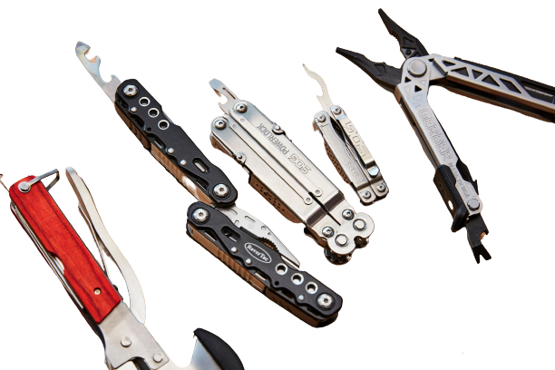

Problem slide
Multiple tools = INCONVENICE
Solution?
Create a multitool!
Oversaturation?
Now what?
Multitool
Niche
Eureka!

Slide 3
Solution slide

Slide 4
The Design Process

Slide 5
Product Specifications

Slide 6
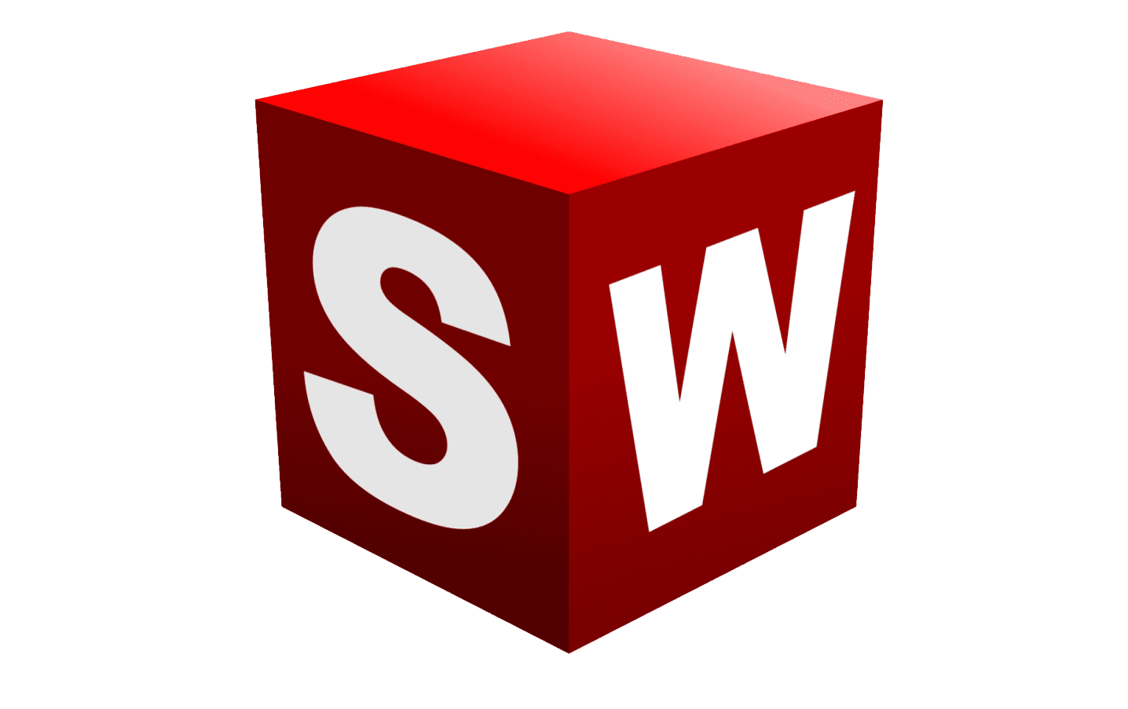
Final 3D Model

Slide 7



Simulation of Mechanisms

Slide 8

User interface and choice of aesthetic

Slide 9
Design for Manufacturing

Slide 10
Design for Assembly

Slide 11

Economic Analysis and BOM

Slide 12

Future Innovations

Slide 13

Conclusion

Slide 14
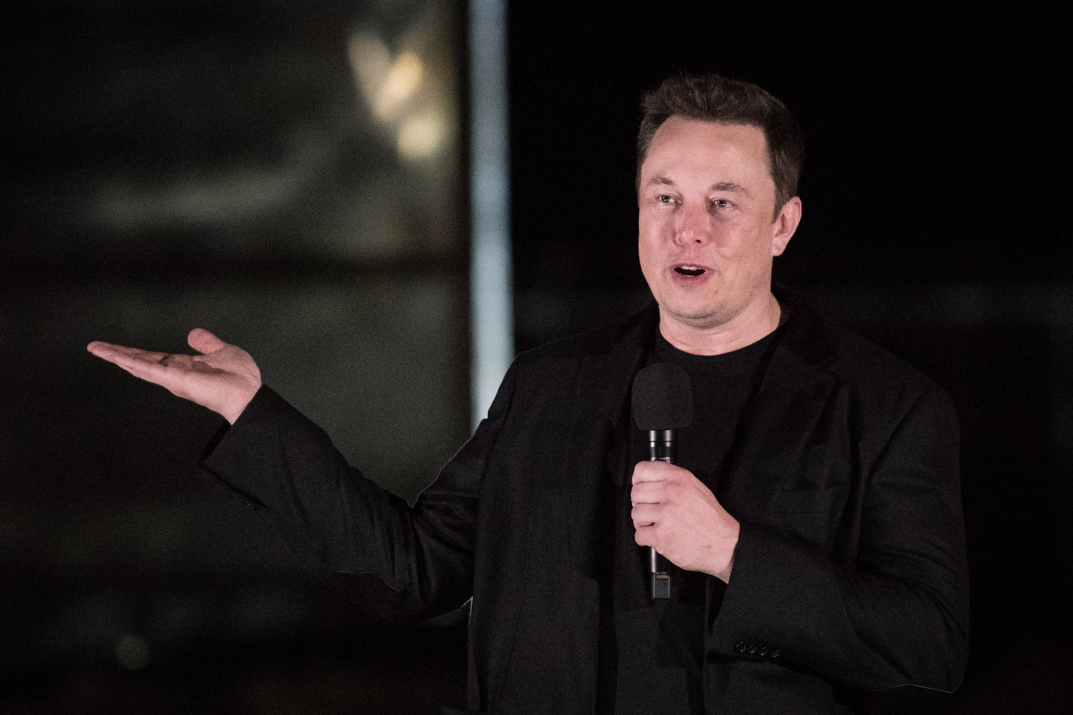
The End
Notes:
ELON MUSK APPROVED
Thank you for listening.

